Slide 1
Clustering of Suburbs in Brisbane

Slide 2
Problem
The following information could be of great help to someone who is looking to relocate to a similar suburb he/she is living in and start a business. Teneriffe is the current location for this case and Indian Restaurant as the business :
Which suburbs of Brisbane are like Teneriffe?
What are top 10 most common business in that neighbourhood? (His/her business might have more chances of flourishing in that region where there is no Indian Restaurant in the top 10 most common venues as there will be less competition)

Slide 3
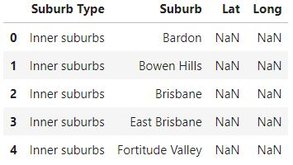
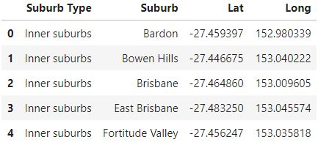
Data Sources
The list of Suburbs in Brisbane was taken from Wikipedia and compiled into a CSV file which was imported into a pandas dataframe.
The Latitude and Longitude values of the Suburbs were obtained using the geopy.geocoders library and populated in the dataframe.

Slide 4
Problem
The following information could be of great help to someone who is looking to relocate to a similar suburb he/she is living in and start a business. Teneriffe is the current location for this case and Indian Restaurant as the business :
Which suburbs of Brisbane are like Teneriffe?
What are top 10 most common business in that neighbourhood? (His/her business might have more chances of flourishing in that region where there is no Indian Restaurant in the top 10 most common venues as there will be less competition)

Slide 5
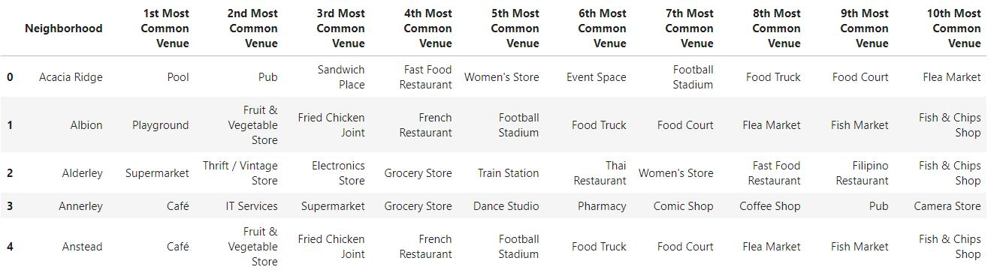
Listing of Top 10 Venues in each suburb
The Foursquare API was then used to identify around 100 venues in the 500 meters radius for each suburb. The results obtained were then normalized by calculating the mean through the onehot encoding technique and top 10 most common venues were listed for each suburb.

Slide 6
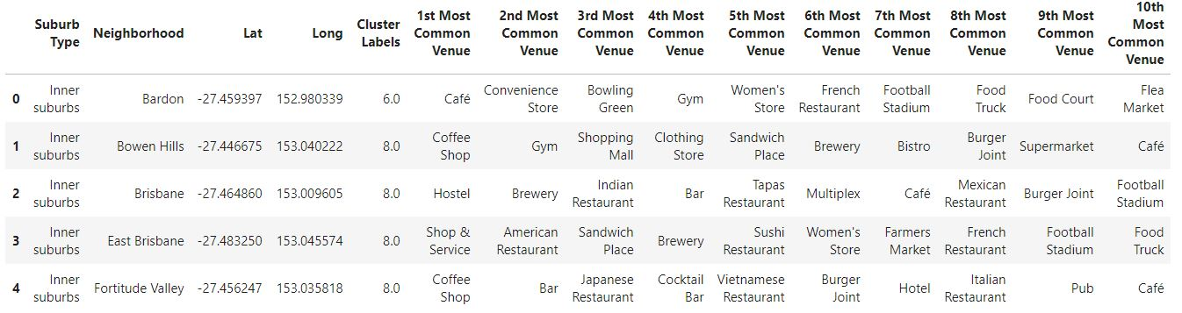
k-Means clustering
Using k-means clustering technique, each of the suburb were clustered and allotted a cluster number.

Slide 7
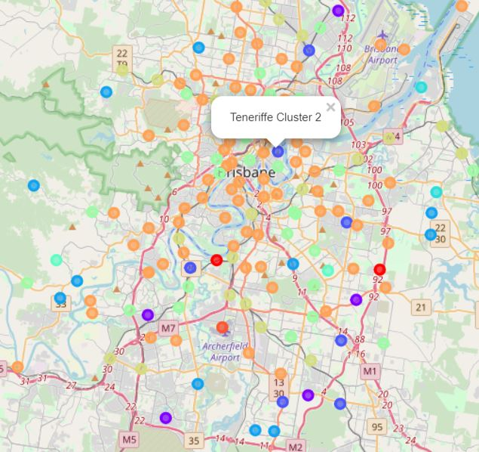
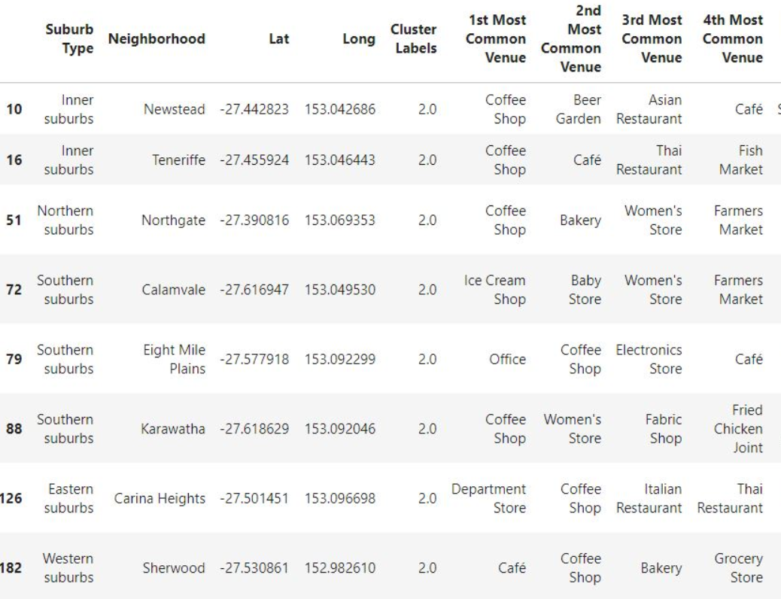
Concluding representation

